Slide 1
UCSD 2023 Defense

Slide 2
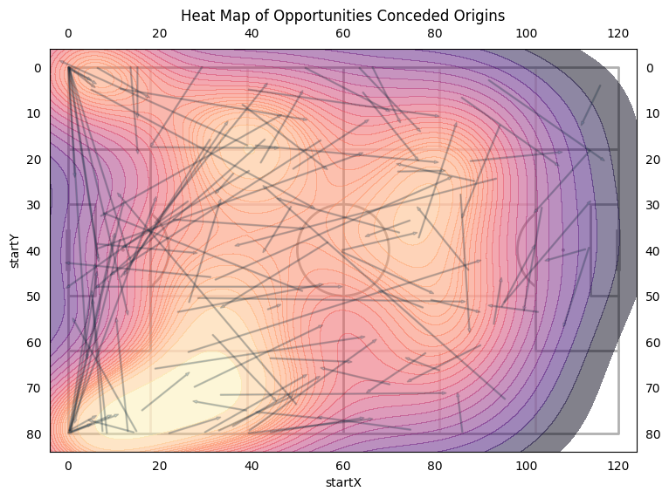

Slide 3
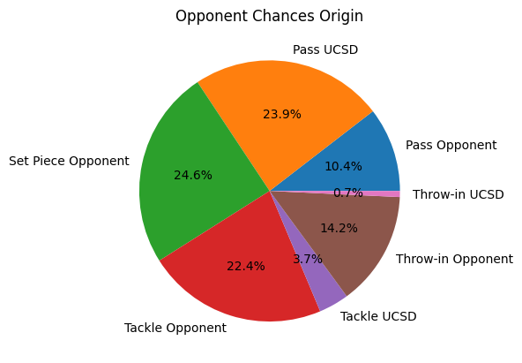

Slide 4
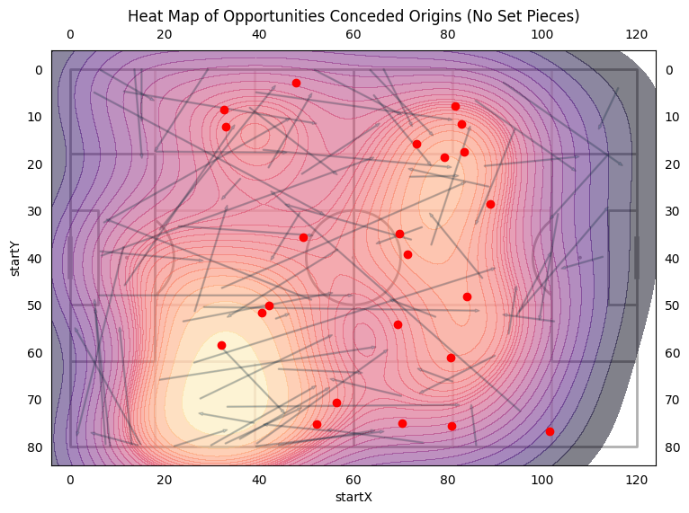

Slide 5
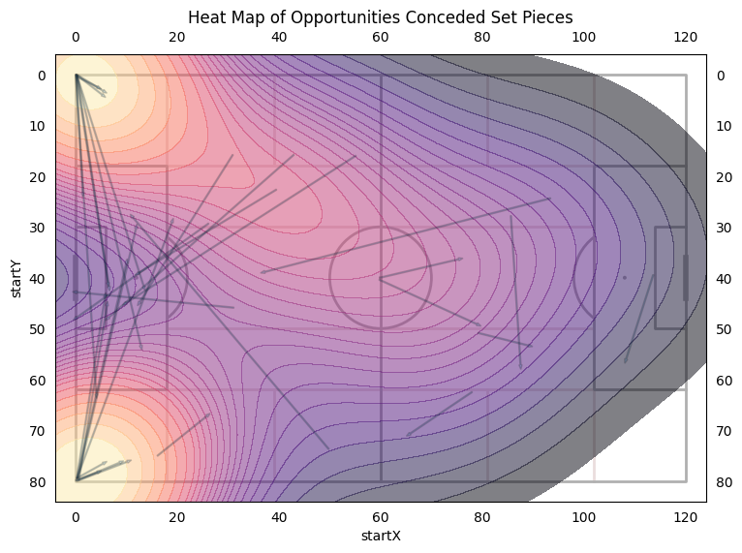

Slide 6
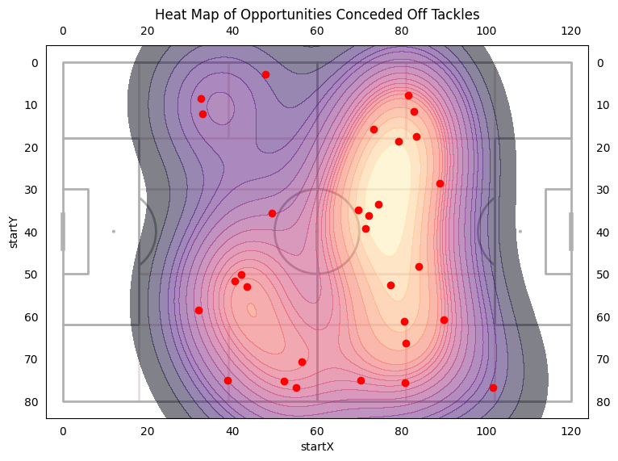

Slide 7
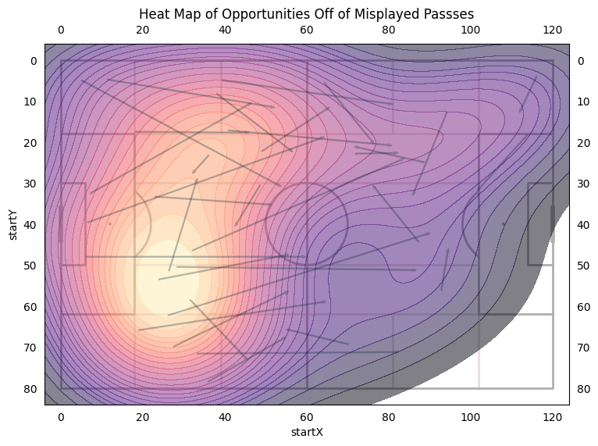
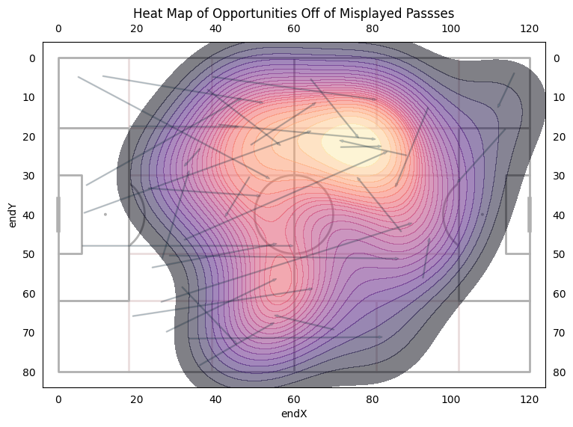

Slide 8
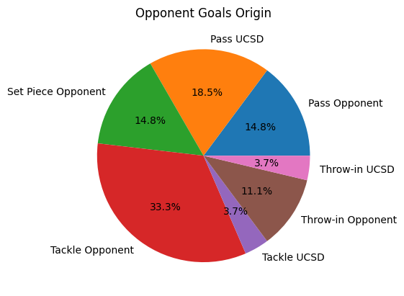

Slide 9
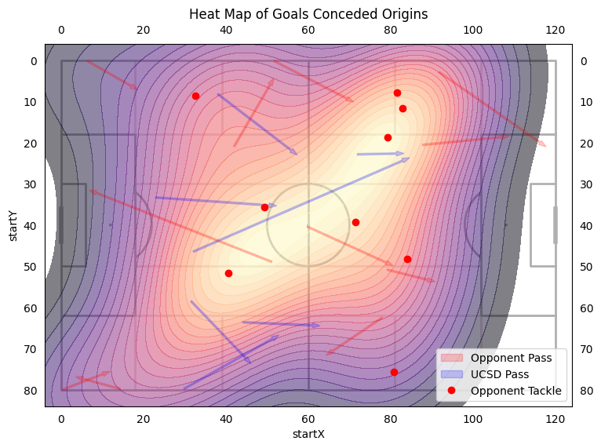

Slide 10
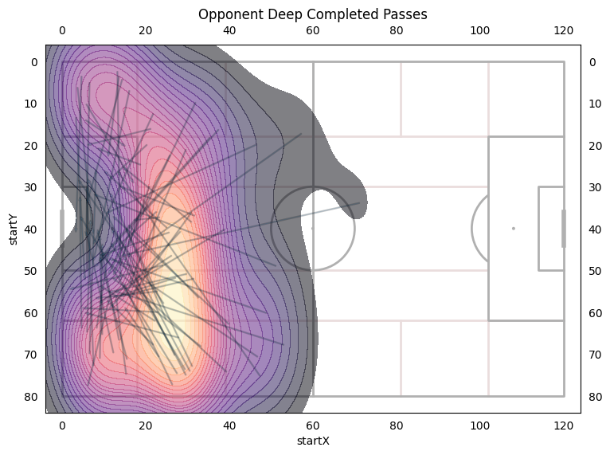

Slide 11
8.8
Average Deep Completed Passes per Game

Slide 12
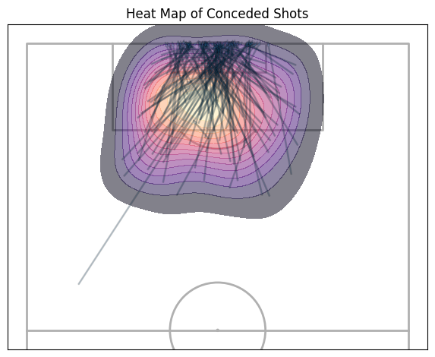

Slide 13
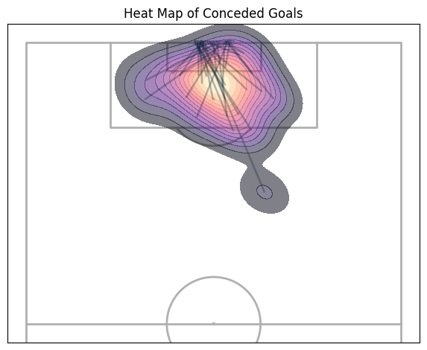

Slide 14
65.4%
88.8%
Opponents shots were within our box.
Opponents' goals were within our box.

Slide 15
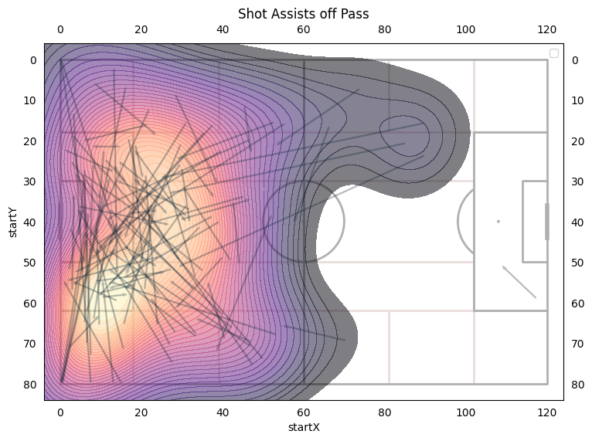

Slide 16
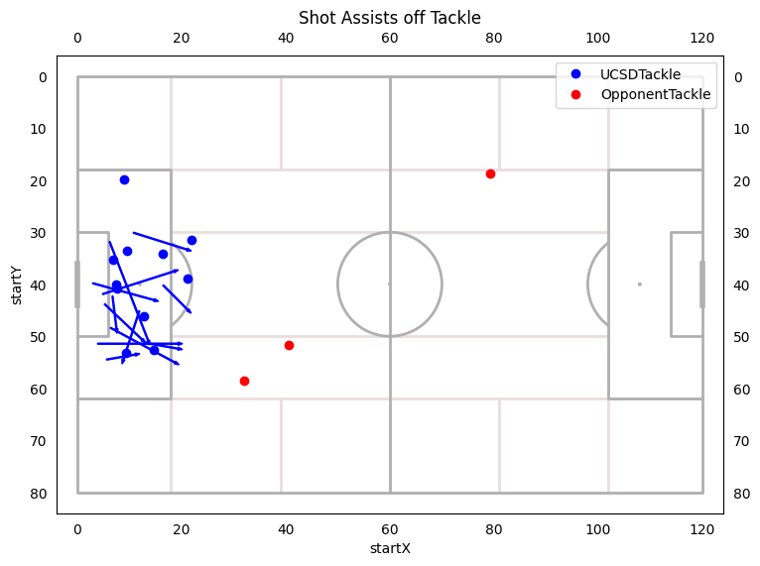

Slide 17
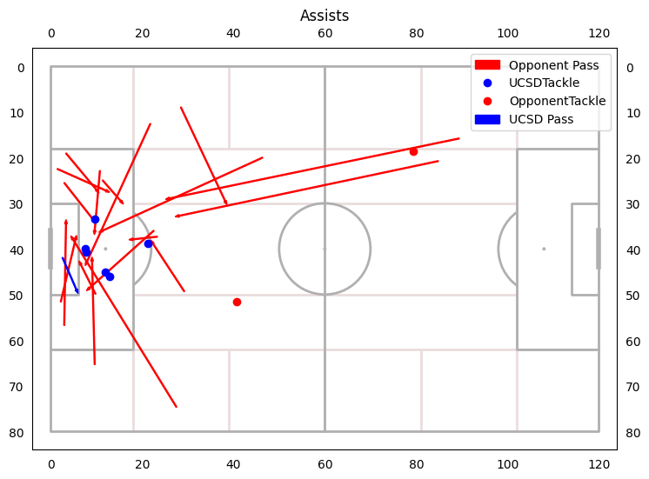

Slide 18
Shot Assists / Assists
81% of shots assisted by a pass
19% of shots assisted by a tackle/block
59.2% of assists are also deep completed passes
30% of assists are tackles/blocks

